Slide 1
2026 CCL Annual Meeting
A look back at CCL events, projects, volunteers, and priorities for the year ahead
Croatan Civic League
Thank you to the neighbors and volunteers who made this year possible.
Notes:
Source: User-provided Annual Meeting Recap document and user-requested annual meeting goals.

Slide 2
Todays Agenda
Welcome
Board Elections
Recap of CCL activities for the past year
Financial Recap
Questions
Notes:
Source: User-provided Annual Meeting Recap document and user-requested annual meeting goals.

Slide 3
Elections
The following residents are up for re-election for the 2027 – 2028 years
Mike Kelly
Michael “Connie” Agresti
Amber Alvarez Torgerson
The following residents are new candidates for the 2027 – 2028 years
Chuck Womack
Nic Masarone
Mary Adams
Tony Aiken
Notes:
Source: User-provided Annual Meeting Recap document and user-requested annual meeting goals.

Slide 4
Community Events & Traditions
Social gatherings and neighborhood activities that brought Croatan together.
Neighborhood Events
Family Events
Annual Meeting - Katie Ripberger
Halloween Block Party - Amanda Robinson; Matt & Christina Michels
Holiday Member Social & Ugly Sweater Contest - Katie Ripberger
Pictures with Santa - Amanda Robinson
Spring Member Social - Katie Ripberger
Hot Chocolate & Cookies with Santa - Amanda Robinson; Patty & Tyler Volpe
Spring Fling - Mike Kelly and volunteers
Holiday Lights Contest - Carol Skarbek; Connie McKenzie
Neighborhood Garage Sale - Bob Lougen
Ice Cream Socials - Amanda Robinson; Patty & Tyler Volpe
Croatan “Be Bone Strong” Walking Club - Barbara Hannah Grufferman and Bettina Armour
Croatan Cares 5K Family Walk/Run - Amanda Robinson
Croatan Civic League
Notes:
Source: User-provided Annual Meeting Recap document and user-requested annual meeting goals.

Slide 5
Projects & Operations
Behind-the-scenes work that keeps CCL active, visible, and responsive.
Neighborhood Improvements
Ongoing Operations
Beach replenishment completed - Mike Kelly
Security patrols & safety updates - Connie Agresti
Rudee Inlet Weir Structure Improvements Study - Mike Kelly, Bob Lougen, Chuck Kubic and Wes Laine
Dominion Energy donation - arranged by Bob Lougen
Front entrance landscaping - Cheryl Garvey
Monthly Newsletter – Martha Kelly
Roads & streets - Frank Borum
Communications, membership, website & social media - Bob Lougen
Flags on Croatan Road - Cheryl and Bill Garvey; Jim Skarbek
Meeting minutes - Mike Fantozzi
Monthly financials - Chuck Womack
Welcome Wagon- Cheryl Garvey
Croatan Civic League
Notes:
Source: User-provided Annual Meeting Recap document and user-requested annual meeting goals.

Slide 6
Looking Ahead: Proposed Priorities
A simple set of goals to guide CCL beyond the annual events and current projects.
Safety & Security
Neighborhood Improvements
Continue patrol funding, safety updates, and safety communication with residents.
Stay engaged on beach, Rudee Inlet, entrance, streets, and sewer/utility issues.
Resident Engagement
Financial Stewardship
Welcome new neighbors, increase membership, and make it easier to volunteer.
Keep expenditures and events budget-conscious and maintain clear monthly reporting.
Communication
Continue to share relevant information through the newsletter, website, email updates, and social media reach.
Croatan Civic League
Notes:
Source: User-provided Annual Meeting Recap document and user-requested annual meeting goals.

Slide 7
How Neighbors Can Get Involved
Consider choosing one way to participate.
Pick one thing this year.
CCL works because residents step in — even small roles make a visible difference.
Help with one event
Welcome a new neighbor
Join a committee or project
Share ideas
Encourage a neighbor to join CCL
Thank you to every volunteer who helped CCL serve Croatan this year.
Notes:
Source: User-provided Annual Meeting Recap document and user-requested annual meeting goals.

Slide 8
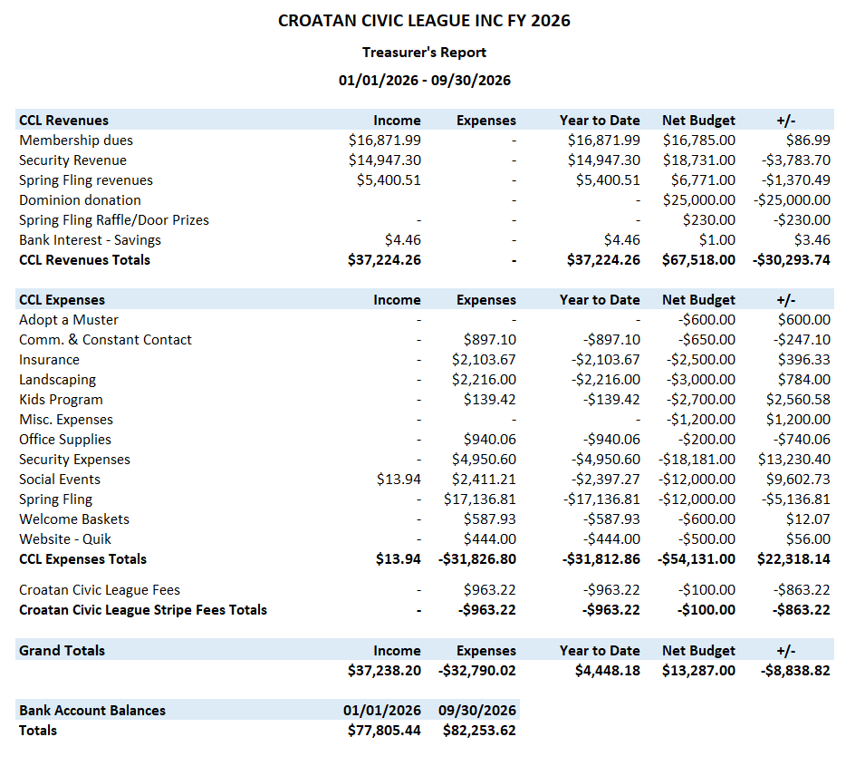
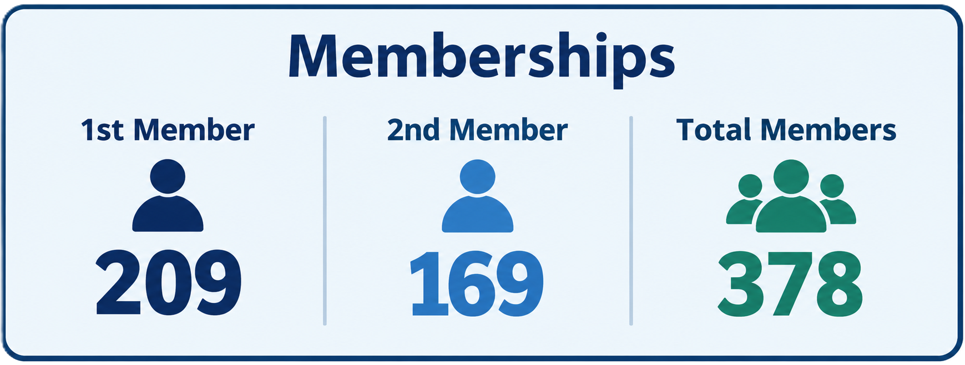
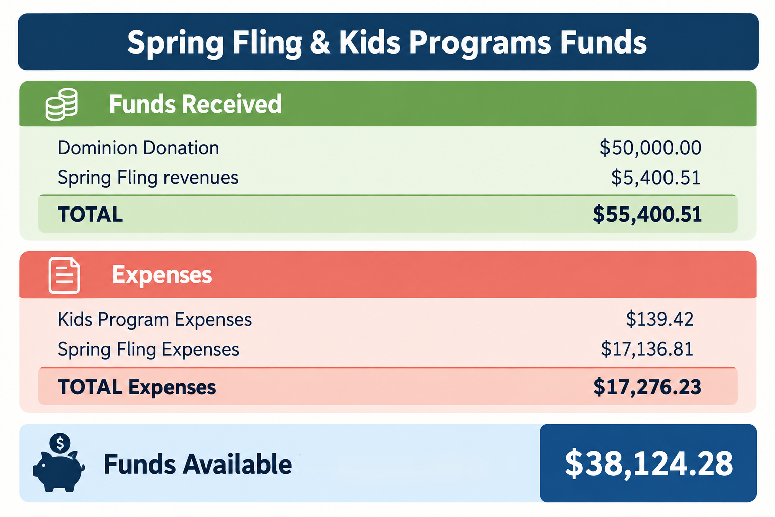
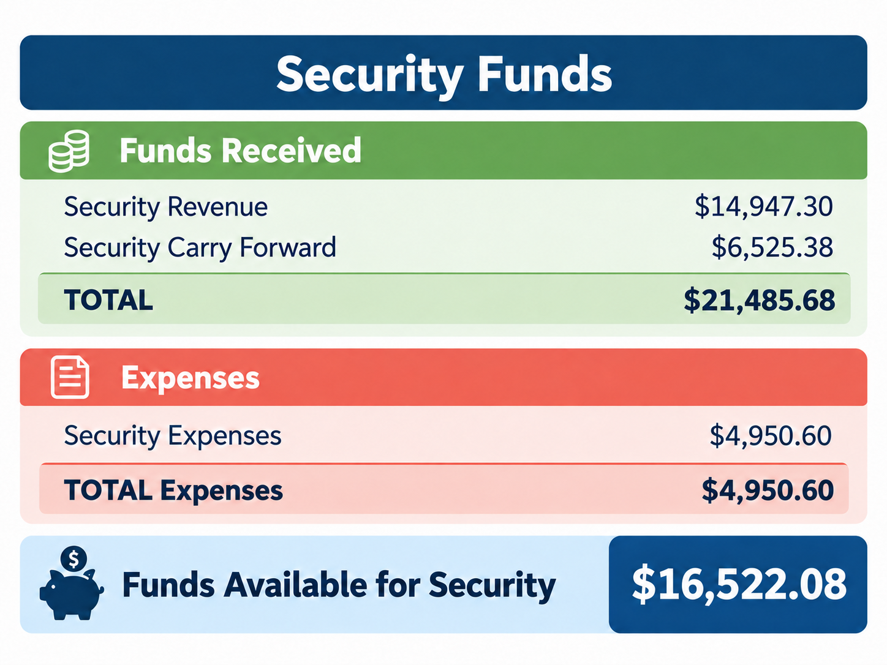
Financial Recap
Notes:
Source: User-provided Annual Meeting Recap document and user-requested annual meeting goals.

Slide 9
Questions?
Notes:
Source: User-provided Annual Meeting Recap document and user-requested annual meeting goals.

